Slide 1
Using the Need For Change
Self-Rating Scale in the CES Project
Onboarding new hires in mental health agencies
4/2024, updated 3/2025, updated 11/2025
Vocational Services

Slide 2
Viewing recommendations:
Jot notes.​
Take screen shots.​
Take photos using your cell phone.​
Learn at your own pace.​
Review segments as you see fit.
This mini-training is approximately 10 minutes

Slide 3

Welcome:
By the end of this slide deck, you will know:​
Who provides employment services in your agency​
How the CES project interfaces with your mental health agency​
Why we use the Need For Change Self-Rating Scale (NFC)​
How to refer people you serve to the Employment Specialist on your team​
The process of the NFC at your agency​
FAQ troubleshooting

Slide 4

Who Provides Employment Services?
Vocational Services at MaineHealth has been providing employment services to individuals with disabilities for over forty years. Its mission is “to contribute to the health and wealth of the community by supporting individuals to overcome barriers and achieve meaningful employment.”​​
Vocational Services currently provides two statewide services:​​
Benefits Counseling / Work Incentives Planning (2002 – present) ​​
Behavioral Health Community Employment Services (CES) (2008 – present)​

Slide 5
How the CES Project Interfaces With Your Agency:
An Employment Specialist is integrated into your mental health agency
They have an office in your facility allowing for frequent team and client contact ​
They regularly attend mental health team meetings to discuss treatment for the people served by your agency ​
They carry an intensive caseload of 20 motivated employment seekers and a portfolio of 20+ employer contacts

Slide 6
This embedded model of care comes from:​
The contract agreement your mental health agency has with MaineHealth Vocational Services regarding employment service provision as part of the originating DHHS-OBH/DOL-BRS contract. ​
The evidence-based Individualized Placement and Support (IPS) model, which has measurable and rigorous standards that are tracked using a 25-point fidelity scale, and eight core principles.

Slide 7
The IPS model includes “Zero Exclusion” as both a core principle of IPS, and a criteria in the Fidelity Scale for this model. ​
​
Zero Exclusion means that if a person expresses a desire to work, the Employment Specialist and treatment team will work with the person to find employment.​
One way Zero Exclusion can be met in the CES project is by all care coordinators/case managers providing the Need For Change Self-Rating Scale to ALL eligible clients receiving services at the agency.
​

Slide 9
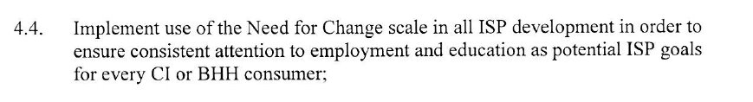
The NFC Process in the CES Project:
Always use at client intake to CI/Section 17 and/or BHH/Section 92 services​
Always use at every 90-day treatment plan review
See below for language in your agency’s agreement with MaineHealth Vocational Services, Community Employment Services (CES) project:

Slide 10
The Ongoing NFC Process in the CES Project:
Also use the NFC …
If/When a person changes their mind about wanting employment​
With the “What is Supported Employment?” flyer (typically at intake)
With the contact info of the IPS Practitioner on your team

Slide 11
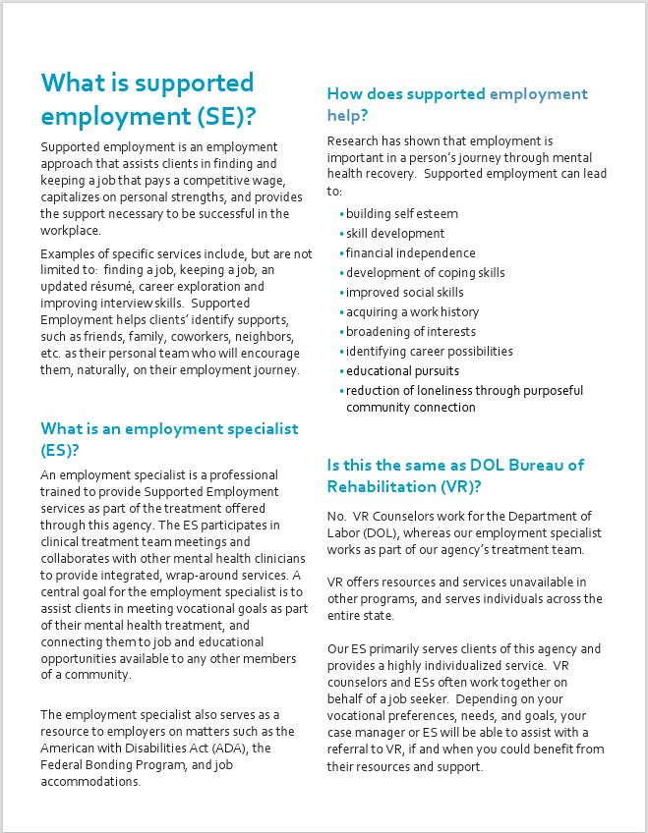

Slide 12
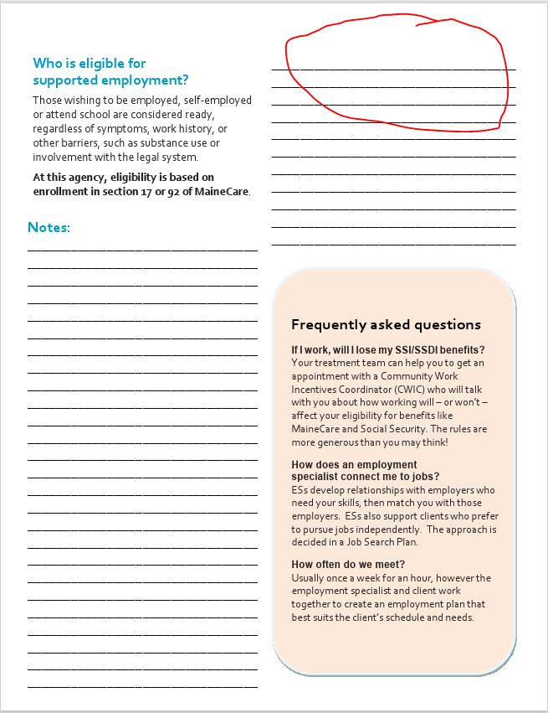
Affix Employment Specialist card here.
Notes:
ES business card can be stapled at the red oval so it doesn’t get lost.

Slide 13
A Sample Script for Case Managers to use when presenting the NFC:
“This is a “Need for Change Self-Rating Scale” asking you to rate how you feel about working or going back to school. Our agency is committed to helping you with these areas and has an IPS Practitioner who can assist you with employment or school related goals.​
It will take you less than 3 minutes to fill out, if you have any questions or would like me to read it to you, I’d be happy to do so. Remember there are no right or wrong answers, and your answers should come totally from you. The scale looks at how much you would like to go to work or school. That may be a lot or a little, depending on how you feel.​
Many of the consumers that I work with are concerned about how work might impact the benefits they receive. Over the years the Social Security Administration and MaineCare have made changes to rules regarding how work can impact benefits. If you would like to learn more just check the box that says, “I would like to learn more about the impact of work on my benefits” and I’ll connect you with a Benefits Counselor.​ Knowing the facts about how income impacts benefits will support you to make an informed decision about your future.
We believe that work can aid in your recovery process regardless of your past work experience. Please simply answer the questions based on how you feel today.”

Slide 14
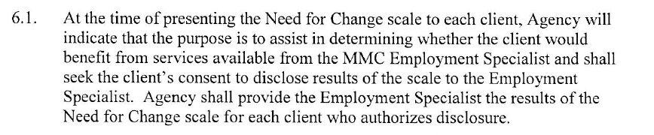
Helpful Hints:
Every case manager is required to do the NFC with all Section 17/92 clients​
See below for language in your agency’s agreement with MaineHealth Vocational Services

Slide 15
Helpful hints (con’t)
Employment Specialist receives all completed NFCs​
MaineHealth Vocational Services reports to DHHS quarterly on all NFCs received and their answers​
Employment Specialist is required to carry a caseload of 20 clients consisting of those with:​
an URGENT NEED for change, ​
followed by those with a STRONG NEED for change ​
regarding EMPLOYMENT (before educational goals)

Slide 16
Eligibility for the CES Project:
Job seekers are eligible to work with the CES Employment Specialist when they meet the following criteria:
MaineCare Section 17 or MaineCare Section 92
Locus score of 17 or higher
High or Urgent ‘Need for Change”

Slide 17

FAQs and Troubleshooting

Slide 18
What happens when the Employment Specialist role is vacant?
Continue doing NFCs, no matter what! ​
Your most urgent NFC clients can be passed to the CES/IPS Supervisor for immediate assistance. ​
You and your agency can continue to connect your clients to job seeking resources such at DOL Vocational Rehabilitation while we advertise for a new IPS Practitioner. MaineCare allows for case managers to support consumers with career exploration – consider taking your client to the closest CareerCenter, and/or helping them access CareerCenter resources on-line. ​
Recognize that employment is an important healthcare indicator and matters to many people you serve. If that domain of service goes unfulfilled due to lack of an employment specialist, understand that the implicit message to your clients may be that you don’t see them as having the skill, capability or competence to be employed. Would your team stop seeking housing for people served if the housing specialist position were vacant? Would people stop receiving medication if the psych nurse position were vacant? No; the same holds for employment. ​
Find ways to continue to keep vocational hopes and dreams part of your regular communication with people you serve as routine and best practice at your mental health agency.
​

Slide 19
Who do I ask when I’m not sure what to do?
The host agency contract agreements with MaineHealth establishes that your agency facilitates the coordination of services regarding the Need For Change scale for all MaineCare section 17 and 92-eligible consumers receiving agency services. This means that any unanswered questions or specifics related to standard operating procedures for the NFC at your agency are best referred to your program supervisor or manager on your team. Your agency ensures delivery and completion of the NFC and provides completed NFC forms to your IPS Specialist at least monthly.

Slide 20
How does one complete the form?
The Need for Change is a “Self-Rating” scale. As such, it is completed by the person seeking services. Case managers and care coordinators can assist someone by clarifying intent, though they would not complete the NFC on someone’s behalf without their knowledge. The responses are those of the client.
When someone responds high or urgent about their need for change, filling out the form completely helps facilitate the connection to the IPS Practitioner without hiccups. When someone is unsure, they, too, complete the form to be connected with an IPS Practitioner for more information on whether they would like to proceed with vocational support.
People may not have a need for change in their life at a point when they are offered the NFC. In this case, we still collect data based on the NFC responses including case manager, client name, age and gender; when/if someone would be inclined to seek a connection to an employment specialist and/or to a Certified Work and Incentives Counselor; and permission to release the form to the employment specialist on the team.
People have agency over the services provided to them. We respect that. Our goal is to collect proper data in order to continuously improve services. When responses are left blank, it’s unclear if someone overlooked the questions, didn’t understand how to respond, or simply didn’t choose to respond. Encourage clients to complete the form by answering all the questions, even if the response is an X, a line or N/A.

Slide 21
What if someone is “triggered” by the NFC request?
The goal of the NFC is to provide opportunity and hope for the people we serve to consider employment and education as part of their individual plan for overall health. The routine, 90-day NFC process provides the opportunity for someone to consider how they may want their future to unfold.
We believe people have agency over their own lives and, like the rest of us, may change their minds about their life goals and directions for a variety of reasons from day-to-day, and over their life-span.
Employment is a choice. We want people to understand that they are being offered a choice to learn about how benefits may be impacted by employment so they may plan financially, just like anyone else. We want them to recognize that the decision to work is a right they have. We also want them to know we honor their right to change their minds about their future.
No one is forced to complete the NFC. Every 90 days, they can respond by declining to respond, which can be noted on the form. We do not believe in taking away an individual's right to choose for themselves which is why we continue to offer the NFC.

Slide 22
Resources:
Community Employment Services Project | MaineHealth

Slide 23
Nancy Litrocapes, MSEd, CIPS
IPS Trainer and Liaison,
Community Employment Services Project,
MaineHealth Vocational Services
Nancy.Litrocapes@mainehealth.org

